Slide 1
SPR binding assays

Slide 2
SPR assays: smart Db/peptides binding to his-P14
Instrument: Biacore™ T200 | Cytiva
Experiment setup:
CM5 chip
running buffer 10 mM HEPES pH 7.4, 150 mM NaCl, 0.005% Tween-20
Protein samples:
Soluble purified
smartDb empty
smartDb/gp33
smartDb/gp33 PF
smartDb/gp33 Y4F
smartDb/fluNP
His-P14

Slide 3
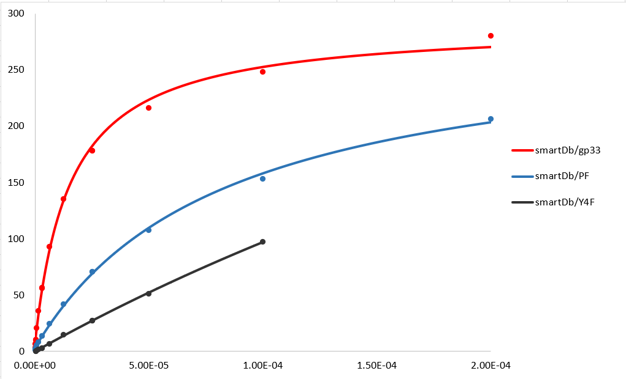
SPR results: smart Db/peptides binding to his-P14
For each experiment, all pMHC dilutions up to at least 100μM
the sensorgrams are fitted by steady state affinity mode
 | K_{D} (μM) | Rmax( Ru)
smartDb empty | No binding
smartDb/gp33 | 13.3-15.4 | 280
smartDb/gp33 PF | 82.6 | 206
smartDb/gp33 Y4F | 593 | 97
smartDb/fluNP | No binding

Slide 4
SPR assays: smart A2/peptides binding to his-1G4
Instrument: Biacore™ T200 | Cytiva
Experiment setup:
CM5 chip
running buffer 10 mM HEPES pH 7.4, 150 mM NaCl, 0.005% Tween-20
Protein samples:
 | concentration
smartA2 empty | 9.1 mg/ml
smartA2/pp65 | 9.8 mg/ml
smartA2/9C | 9.8 mg/ml
smartA2/9V | 9.9 mg/ml
hHLA-A2/9V | 8.4 mg/ml
His-1G4 | 6.7mg/ml

Slide 5
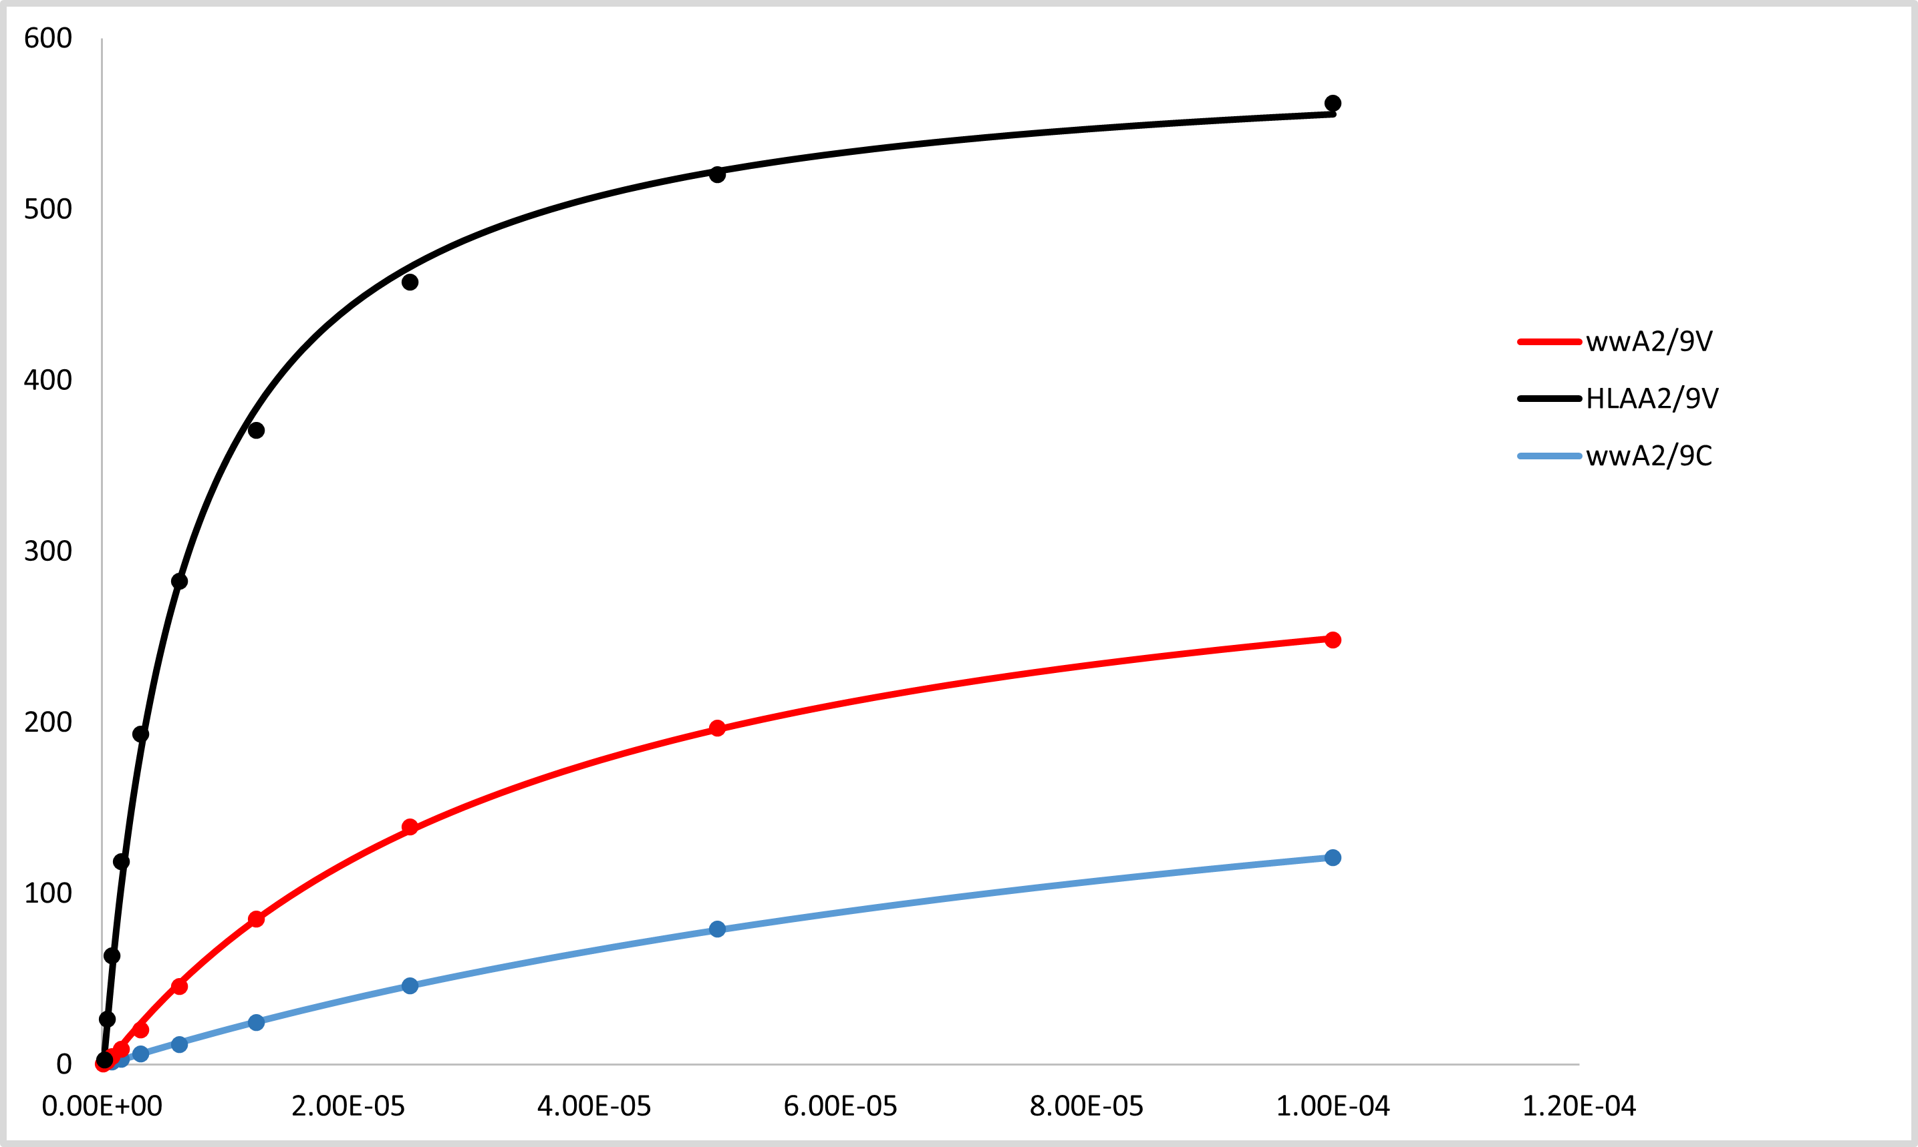
SPR results: smart A2/peptides binding to his-1G4
For each experiment, all pMHC dilutions up to 100μM
the sensorgrams are fitted by steady state affinity mode
Refolded hLAA2/9V as positive control
 | K_{D} (μM) | Rmax( Ru)
smartA2 empty | No binding
smartA2/pp65 | No binding
smartA2/9C | 115.8 | 264
smartA2/9V | 36.5 | 344
hHLA-A02/9V | 6.69 | 601.5

Slide 6
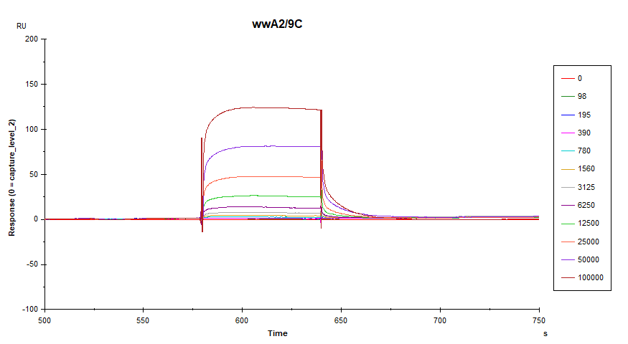
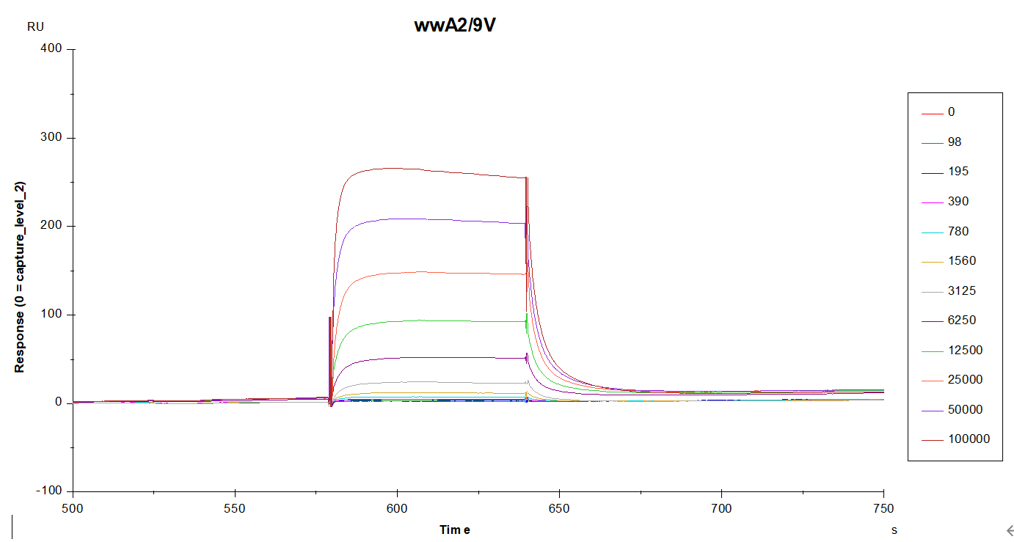
Raw sensorgrams:

